Slide 1

Independent
10 MINUTES

Slide 2
Argumentative Cont.
Subtitle

Slide 3
Review Parallel Structure
Correct the sentences to make them parallel:
  They will not admit their mistake nor will they be apologizing.
  He is man of great talent, ability and who is most intelligent.
  Cathy was not only Sarah’s sister, but also she was her mentor.

Slide 4
STANDARDS
ELAGSE7L1: Demonstrate command of the conventions of standard English grammar and usage when writing or speaking.
  A. Explain the function of phrases and clauses in general and their function in specific sentences.
  C. Place phrases and clauses within a sentence, recognizing and correcting misplaced and dangling modifiers.*

Slide 5
Misplaced and Dangling Modifiers

Slide 6
Q: What is a modifier?

Slide 7
A: a word or phrase that qualifies (modifies) a word, phrase or clause
Types:
  adjectives (modify nouns and pronouns) (for example: the RED house)
  adverbs (modify verbs) (for example: he ran QUICKLY)
  modifier phrases (modify an action or an actor) (LOOKING AT THE CLOCK, he noticed that he was late)

Slide 8
Q: What is a misplaced modifier?

Slide 9
A: a misplaced modifier is a word or word group whose placement suggests that it modifies one word or phrase when it is intended to modify another.

Slide 10
Misplaced Modifiers
More beautiful than any human being, the explorer noticed the mermaid.
Wild and untamed, Jack entered the jungle.
Moaning in haunting voices, the house contained many ghosts.

Slide 11
Q: How do I fix it?

Slide 12
A: Revise the sentence, taking care to put modifying words, phrases, and clauses in a position that clearly identifies the headword and that does not awkwardly interrupt a sentence.
HINT: Usually, you can just expand the main clause.

Slide 13
Examples:
Incorrect: More beautiful than any human being, the explorer noticed the mermaid.
Correct: The explorer noticed the mermaid, which was more beautiful than any human being.

Slide 14
Examples:
Incorrect: Wild and untamed, Jack entered the jungle.
Correct: Jack entered the wild and untamed jungle.

Slide 15
Examples:
Incorrect: Moaning in haunting voices, the house contained many ghosts.
Correct: The house contained many ghosts that moaned in haunting voices.

Slide 16

Q: What is a dangling modifier?

Slide 17
A: A dangling modifier is a word or phrase that cannot logically describe, limit, or restrict any word or word group in the sentence.

Slide 18
Dangling Modifiers
Using a variety of pedagogical techniques, the students were taught grammar.
To improve his essay, each page was proofread.
While reading the novel, the pages that contain important information should be marked.

Slide 19

Q: How do I fix it?

Slide 20
A: Add a word or word group that the dangling modifier can logically modify.
HINT: You must usually change the subject of the main clause.

Slide 21
Examples:
Incorrect: Using a variety of pedagogical techniques, the students were taught grammar.
Correct: Using a variety of pedagogical techniques, the teacher taught the students grammar.

Slide 22
Example:
Incorrect:
To improve his essay, each page was proofread.
Correct:
To improve his essay, David proofread each page.

Slide 23

The boy ate a pizza.
who has a mohawk
loaded with cheese and sausage
Whimpering for a dog bone
Sentence
modifiers
Where do they go?
(choices on next slide)

Slide 24

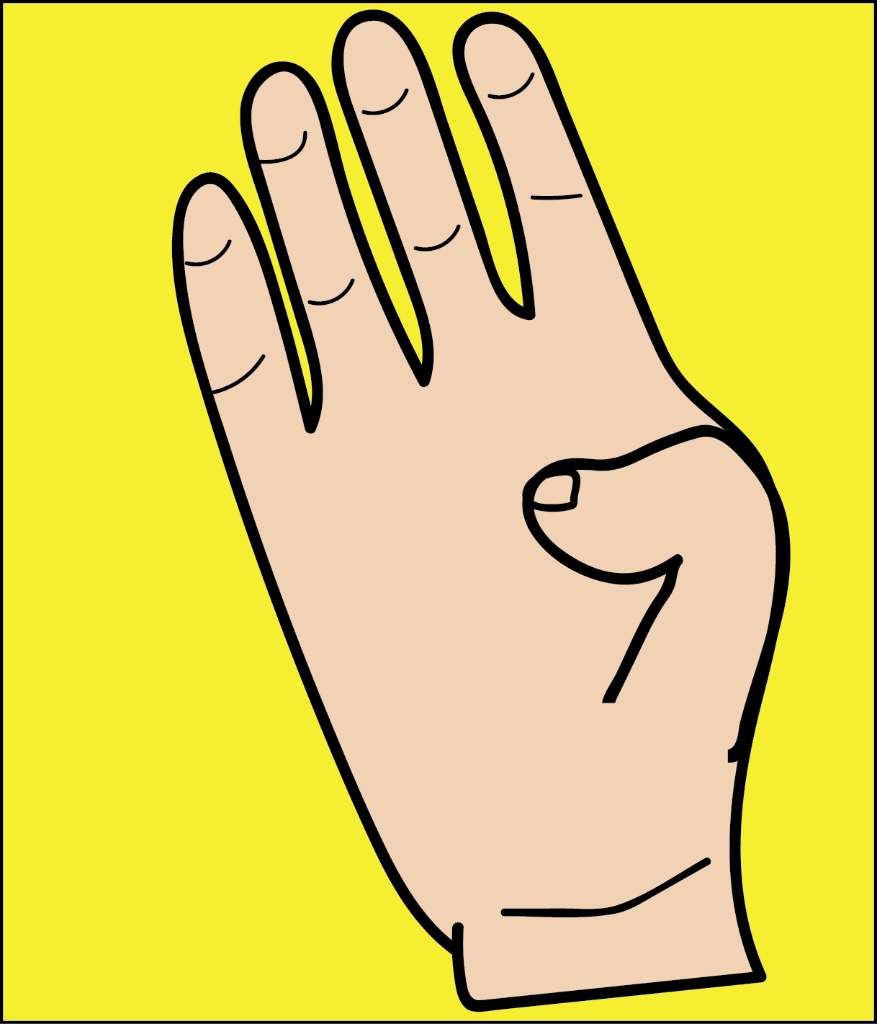



Make the sign for the letter that you think is correct.
Make the
A. The boy, loaded with cheese and sausage, ate a pizza.
B. The boy ate a pizza who has a mohawk.
C. Whimpering for a dog bone, the boy ate a pizza.
D. The boy, who has a mohawk, ate a pizza loaded with cheese and sausage.

Slide 25
ANSWERS:
A. The boy, loaded with cheese and sausage, ate a pizza.
B. The boy ate a pizza who has a mohawk.
C. Whimpering for a dog bone, the boy ate a pizza.
D. The boy, who has a mohawk, ate a pizza loaded with cheese and sausage.
misplaced
misplaced
dangling
correct!

Slide 26
Independent
10 MINUTES

Slide 27

Standard, Essential Question, Differentiation and Student Engagement
Standard: Create a claim and argue a position incorporating counterclaims in a debate.
Analyze the logic in the development of different points of view on the same subject.
Essential Question: How does research improve arguments?
Differentiation: Student selected debate position
Student Engagement: Partner activity

Slide 28
Identify the hook
Almost from the time the downtown No. 4 subway train began its 21-mile run below New York City at 11:38 PM on Tuesday, August 27, something seemed amiss. Heading from the Bronx to Manhattan, the train overshot the platform at a couple of stations. At times it slowed to a crawl and then accelerated to breakneck speeds. The conductor contacted the motorman, Robert Ray, 38, several times on the intercom to find out if everything was all right. Ray replied that he was fine. But that was clearly not the case. It was soon discovered that Ray was being held hostage by gunman. If he'd been allowed to carry a gun himself, neither Ray nor the passengers would have been in any danger. (TS) Subway officials need to implement more safety procedures.

Slide 29

The Great Introduction…
What makes an good introduction?
It grabs or “hooks” the reader’s attention by using one or more of the following strategies:
  An anecdote or scenario
  A quotation
  An interesting fact or statistic
  A question
It tells how the writing will be organized.
The author’s position is clearly stated in a thesis statement.

Slide 30
Lead / Hook
Grab the Reader’s Attention
Anecdote (narrative vignette) | I walked proudly through the hallways of AMS, my new blue mohawk glistening magnificently in the florescent lighting of the hallway, but then I saw Mr. Caruthers. I felt the wax in my hair start to melt.
Question | Do schools have the right to tell kids how to dress?
Hyperbole | For the past 300 years in this country, schools have been crushing the artistic freedom of students with oppressive dress codes!
Setting | At Centerville Middle School, a controversy is brewing. Walk down the hallways, and amidst a tranquil sea of khaki pants and navy blue polo shirts, the blades of a fuchsia mohawk cut through the peaceful learning environment.
Alliterative Phrase | Timeless. Tasteful. Tried and true. The traditional school uniform is the foundation of a true learning environment.
Quotation | “Give me liberty or give me death.”
Notes:
Here are some possible leads for a persuasive paper about school dress codes. Have students consider tone and audience. Which would be most appropriate?

Slide 31
Next: Creating a Thesis Statement
A thesis statement is one sentence at the end of your introduction that states your opinion. It needs to be strong.
First, choose 2 main focus points to discuss in your essay. These points will become the focus of two paragraphs in the body of your paper.
Let’s use fast food as an example again.
Fast food…(2 Discussion Points)
rapidly increases weight
causes high blood pressure

Slide 32
A thesis statement should
contain a topic (main idea of what you are writing about)
contain an opinion about the topic (what your attitude is toward the topic)

Slide 33
Thesis and Forecast
A thesis statement is always one sentence that states your assertion (belief) about a topic. A thesis statement usually includes a forecast (brief preview of your arguments).
Fortnite is ___________________ because of focus point 1 and focus point 2.
Notes:
Introduce the thesis statement model. Have students practice writing thesis statements with the “I believe” stem until they become proficient. Some students may only need to be shown the example once—others may have to write four or five essays using the stem until they get the idea. I refer to the “I believe” stem as the “training wheels” for thesis statements. Once students are confident in their ability to write thesis statements, they can get rid of the “training wheels.” Show students the correlation between the planner and the thesis statement and forecast.

Slide 34
Writing the Thesis Statement
Now take your two main focus points and summarize them. Put your completed thesis statement at the end of your first paragraph.
TWO MAIN FOCUS POINTS
Fast food is harmful because it rapidly increases weight, causes high blood pressure, and leads to lethargy.
COMPLETED THESIS STATEMENT
Fast food has negative health effects.

Slide 35
Our Introductory Paragraph:
CATCHY TITLE
Fast Food Is Killing America!
Did you know that a typical child needs 2,000 calories for an entire day and Burger King’s Whopper with triple cheese has 1,230 calories? That is far more calories than anyone needs in one day! Fast food consumption has risen 500 percent since 1970 and today reaches nearly every part of society, including some public school cafeterias. Fast food is harmful because it rapidly increases weight, and causes high blood pressure. Fast food is bad for your health!
HOOK THE READER
YOUR THREE ARGUMENTS
THESIS STATEMENT
Walsh Publishing Co. 2009

Slide 36
Independent
10 MINUTES

Slide 37
Five sentences are listed below. Label whether the sentence is a misplaced modifier (M), a dangling modifier (D) or correct (C).
1. Always eager for cake, the birthday party was attended by everyone.
2. Forgetting that the microphone was on, the whole audience heard the singer's fight with his wife.
3. Wagging her tail, the new puppy climbed into my lap.
4. After painting all day, the bright new watercolor was drying in the sunshine.
5. Late as always, Mike made quite an entrance when he came to the party.

Slide 38
Peer check
Put your name on the bottom of the paper after you have exchanged
Rate the hook scale 1-5 1=weak 5=strong put that number on the paper next to the hook
Comment on the background information (too much, not enough, does not fit, good job, etc)
Put an * next to the thesis statement.
Underline the claim and put brackets around the 2 focus points of the essay [ ]

Slide 39
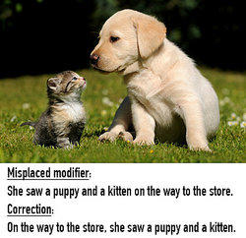
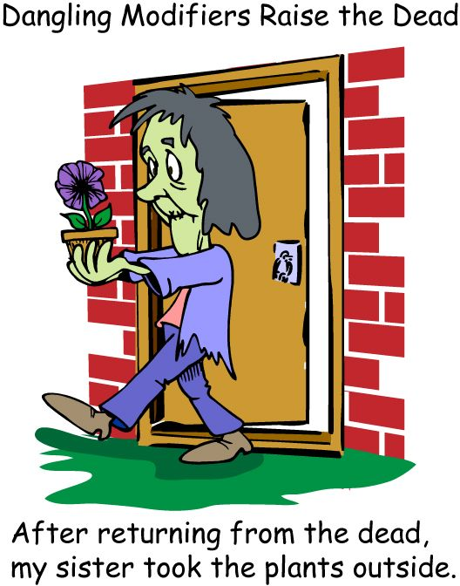
MODIFIERS
MISPLACED
DANGLING

Slide 40
MODIFIERS
Correct the following sentences.
The smoke alarm went off while cooking my dinner.
A young woman knocked on the door wearing a suit and hat.
The sweater belongs to my friend with a v-shaped neck.

Slide 41
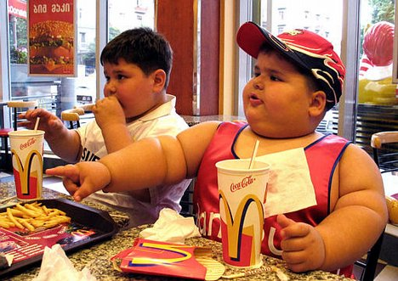
Two Supporting Paragraphs:
Use each of the main arguments you used in your introductory paragraph and expand on each giving facts and reasons.
In our example, you would write one paragraph on how fast food increases weight, and one paragraph on how it causes high blood pressure.
Walsh Publishing Co. 2009

Slide 42
2 Body Paragraphs
Topic sentence - focus points (1-2 sentences)
Textual Evidence (2-3 sentences) –
Starters: The text says…In the article…The article says…
Analysis (1-2 sentences)
  Starters: This means…The significance of this is…This suggests...
  Personal Evidence (2-3 sentences)
  Conclusion (restate topic sentence in completely different words)
  Starters: All in all…, There is no doubt…, There is no question that…

Slide 43
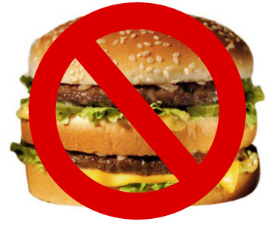
You’ll Need to Show “The Other Side…”
How many of you have been in a discussion with someone and you remember saying, “Yeah, that’s true, but…” This is called a counter-argument. It’s the “other side” of the argument.
You’ll need to tell your reader what the counter-argument is and prove why it shouldn’t matter.

Slide 44
MODIFIERS AND PARALLEL STRUCTURE COMMON ASSESSMENT
Take out a sheet of paper
Head it correctly
Number your paper 1-20
When finished put your answers into IRespond
Put your score on your paper
Turn your answer sheet and quiz sheet in.
Work on your -Body Paragraph Counterargument
Use your notes for this paragraph (pg 8)
Make sure you use the transitional words that are given.
Look at the example at the bottom for a guide.
This paragraph is about 3-4 sentences.

Slide 45
Body Paragraph Counterargument
Use your notes for this paragraph (pg 8)
Make sure you use the transitional words that are given.
Look at the example at the bottom for a guide.
This paragraph is about 3-4 sentences.

Slide 46
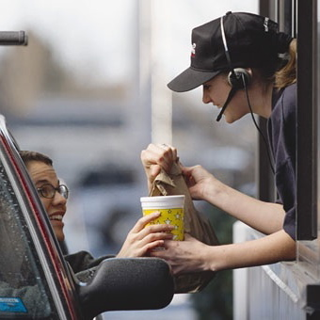
The Other Side of the Story
This is where you should explain why your opposition believes what they believe.
For example:
“A fast food company wouldn’t agree with the points in this essay. They would have lots of reasons why fast food is good. They may say…”it’s convenient” or “It’s fine if eaten in moderation.” These arguments just don’t hold up when you take all the facts into consideration!
Walsh Publishing Co. 2009

Slide 47
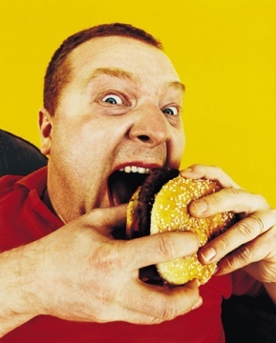
Conclude or End Your Essay…
What makes an good conclusion?
Last paragraph summarizes your main point.
End using one or more of the following strategies:
      Call the reader to action
      Anecdote or scenario
      Make a Prediction
The last paragraph wraps up the writing and gives the reader something to think about.
Walsh Publishing Co. 2009

Slide 48
Conclude or End Your Essay…
What makes an good conclusion?
Last paragraph summarizes your main point.
End using one or more of the following strategies:
      Call the reader to action
      Anecdote or scenario
      Make a Prediction
The last paragraph wraps up the writing and gives the reader something to think about.
Walsh Publishing Co. 2009

