Slide 1
Names of Group Members
Topic Sentence Station
1.
2.
3.
4.
5.
Conclusion Paragraph Station

Slide 2
Lead-Ins (Hooks) Station
1. Lead-In #1
Lead-In #2
2.
3.
4.
5.

Slide 3
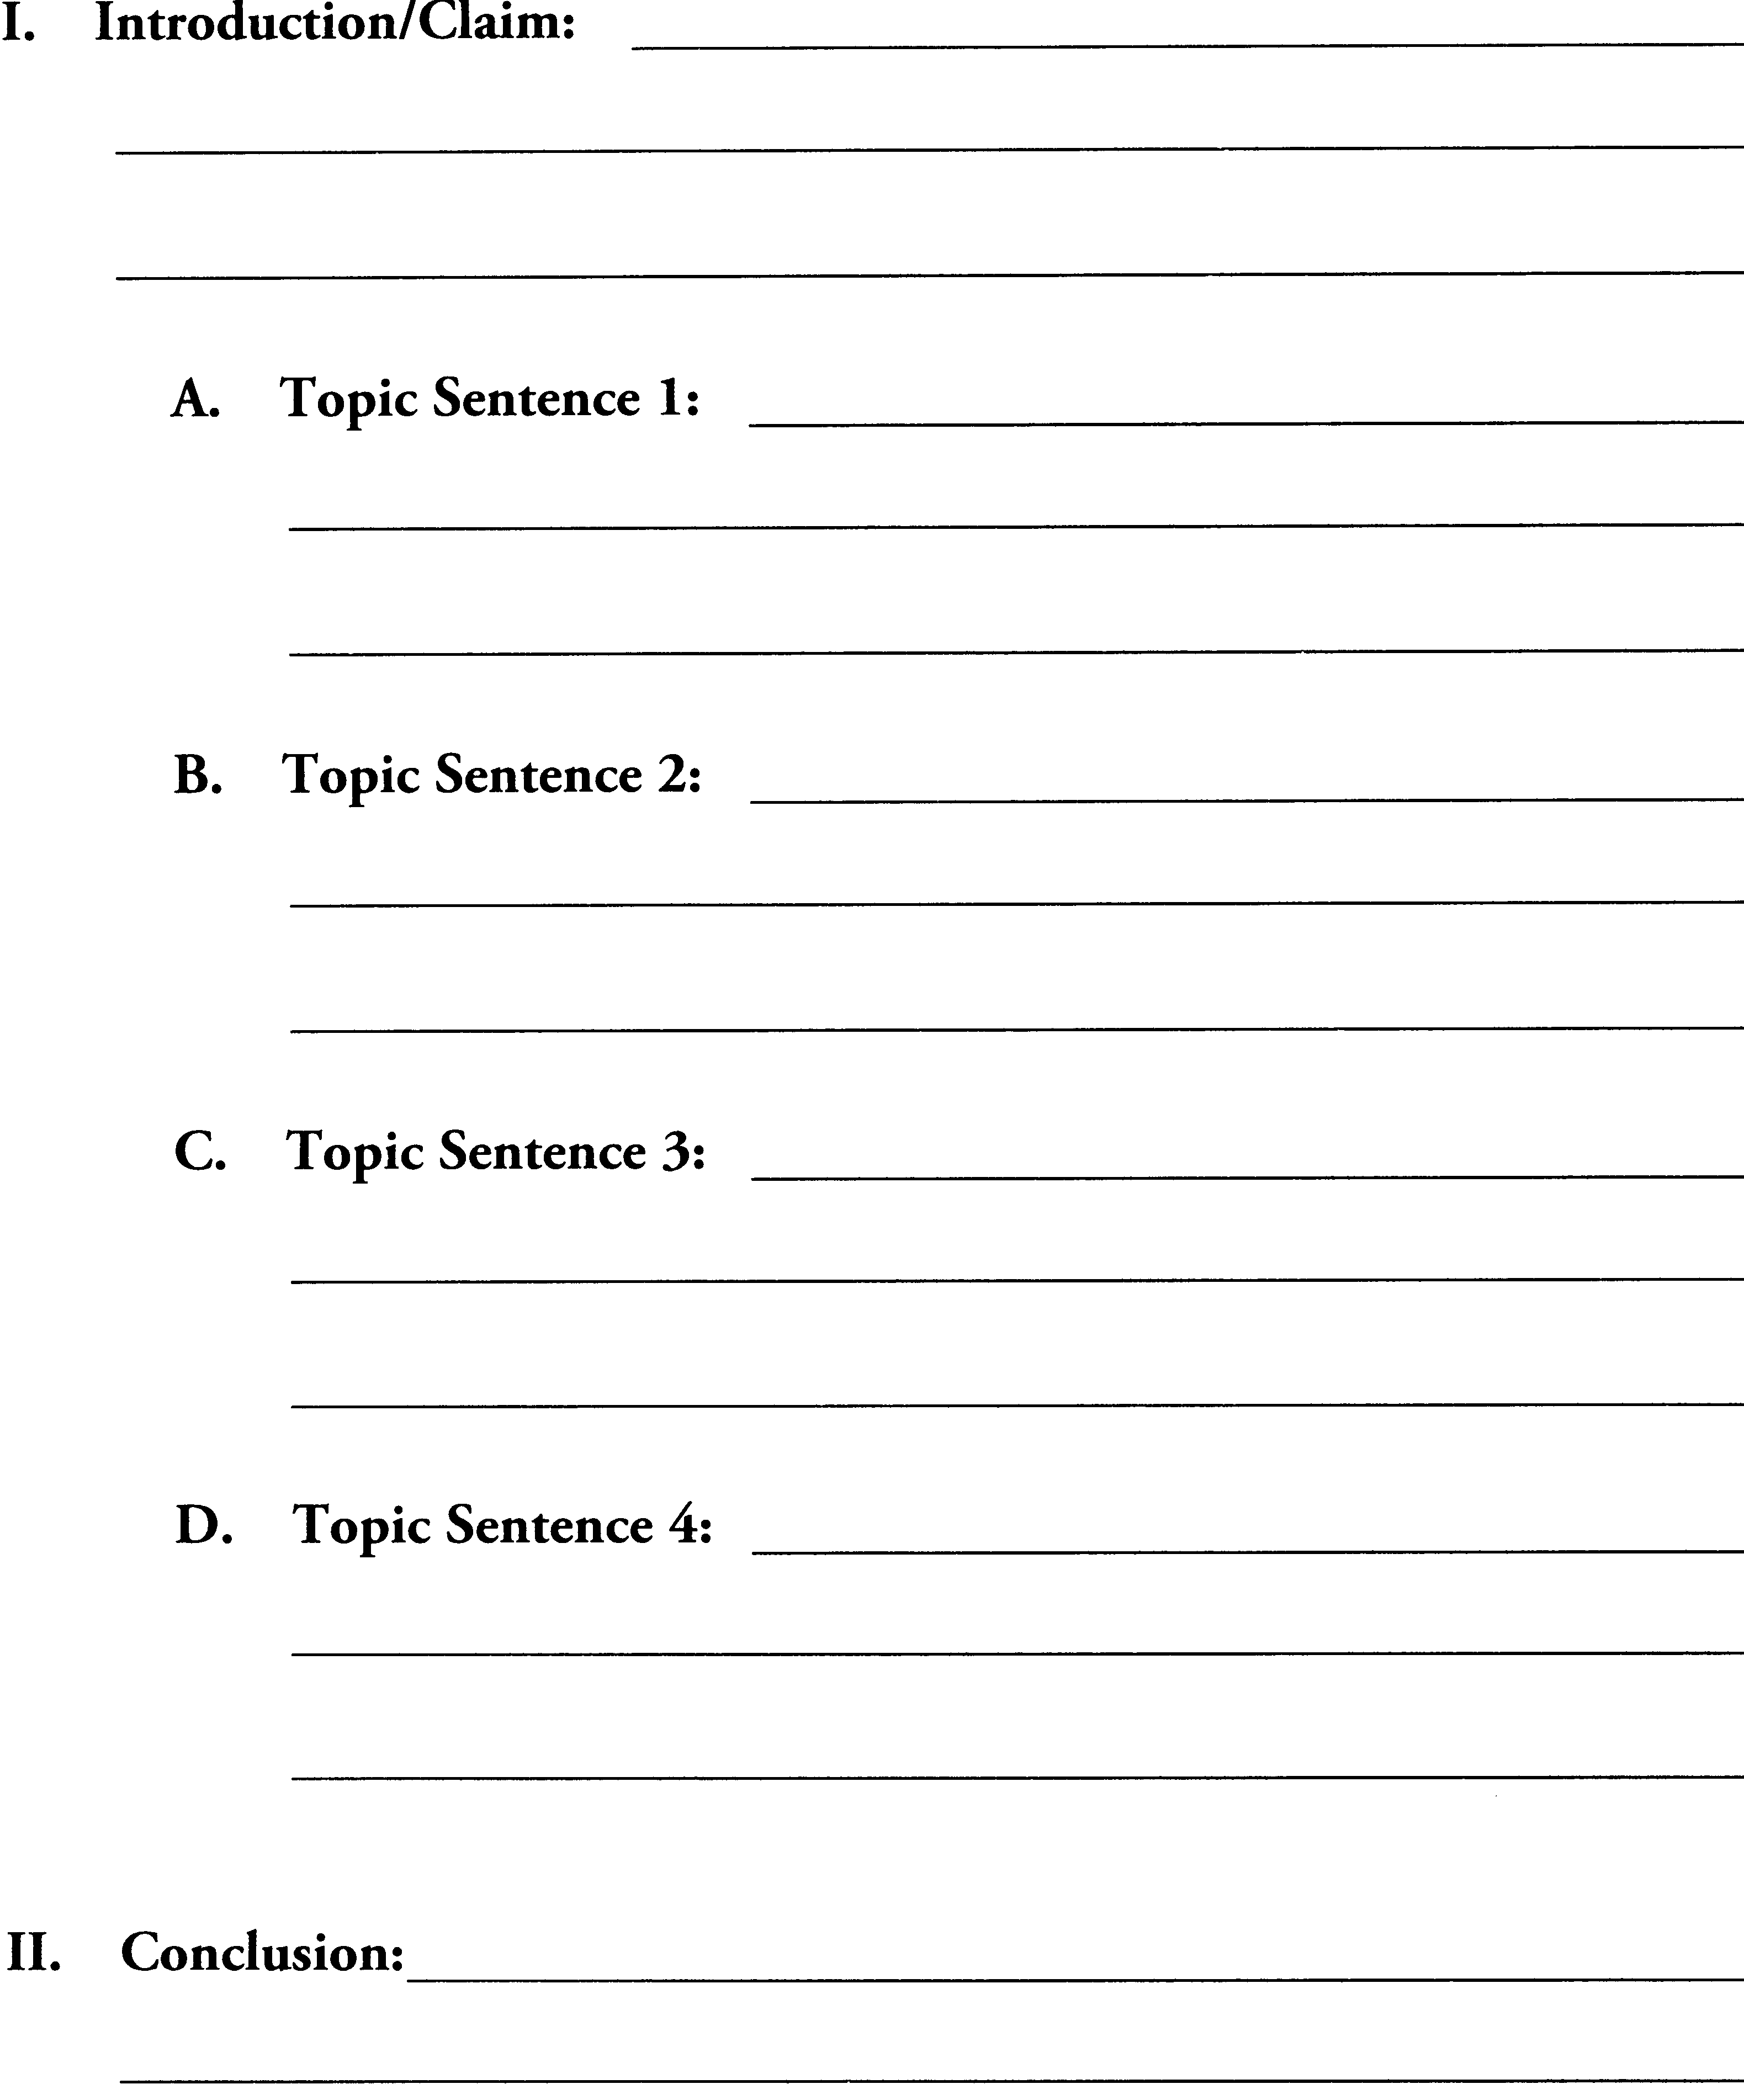
Argument Prompt – Graphic Organizer

