Slide 1
UTOPIA VS. DSYTOPIA

Slide 2
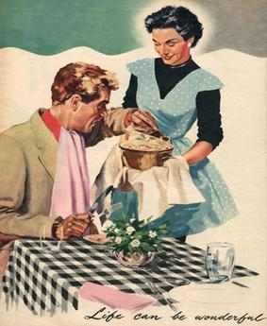
OPENING
Look at this picture of a 1950s housewife.
What is the idea of the American Dream presented in this picture? In what way is it utopic? How is this version of the American Dream different from today's version? How is it the same?

Slide 3
opening
Is a utopia society possible? Why or why not?

Slide 4
The word utopia is made from the Greek words ou-, meaning “no,” and topos, meaning “place.” But it also is similar to eutopia, made from the English prefix eu-, meaning “good,” and topos. This implies that the perfectly “good place” is really “no place.”

Slide 5
Cloze notes

Slide 6
WHAT IS A UTOPIA?
A place, state, or condition that is ideally perfect in respect of politics, laws, customs, and conditions.

Slide 7
In your reading response notebook, draw a cloud like below.
Label your cloud “UTOPIA”
In your cloud brainstorm a list of characteristics that describe a perfect society .

Slide 8
CLASS LIST FOR UTOPIA
Is this list aspects of politics, laws, customs, conditions, or something else?

Slide 9
What is a dystopia?
A futuristic, imagined universe in which life is extremely bad because of deprivation or oppression or terror
A state in which the condition of life is extremely bad as from deprivation or oppression or terror

Slide 10
Common elements of a dystopia
Some dystopias are savage desert wastelands, empty of plants and filled with lawless bandits and warlords. That kind of dystopia isn’t often confused with a utopia though. The really dangerous dystopias are the ones that appear to be perfect on the surface, but are secretly horrible. Here are so common elements of these “totalitarian” dystopias:

Slide 11
Element | Description
The people are restricted from independent thought and action | People are not free to make their own choices in life, the government chooses for them.
The government in control is often oppressive | An oppressive government is often overbearing, has constant surveillance on its people, creates curfews, has military control, and suppresses its people.
The setting is often futuristic or in a fictional universe | The setting is often in the future, or in a fictional universe, after a massive war or catastrophe. This helps explain the different structure of society, and justify the power of government.
Contains elements of conformity, or extreme equality | People are forced to be very similar and conform to the rules and expectations that the government has set forth.
The government portrays their society as a utopia | They use propaganda and subtle manipulation to trick their people into believing things are perfect.
The protagonist wishes to restore the people to conventional life | The main character has a moment of clarity and realizes the problems in the society. They try to make a change to 'free the people'.

Slide 12
Common themes in dystopian novels
1. The dangers of a particular type of government.
2. The importance of knowledge and truth.
4. The danger of allowing one group to have too much power.
3. The danger of a particular policy .
5. The importance of free will and individuality.
6. The danger of technology.
7. The danger of desensitization.
8. The importance of humanity.
9. The danger of human nature.

Slide 13
VOCABULARY
Utopia
Dystopia
Society
Oppression
Surveillance
Suppress
Desensitize
Catastrophe
Conformity
Propaganda
HOMEWORK
Use These Words to Make Flashcards or Use an App - CRAM, QUIZLET, or STUDYBLUE
Word on one side, definition on the other side
Due Friday

