Slide 1
Plot | the time and place in which a story takes place
Character | a struggle, problem, or obstacle in a story
Conflict | the sequence of events that make up a story
Setting | a writer’s central idea or main message about life
Theme | people, animals, or imaginary creatures that take part in a story

Slide 2
Exposition | Background information or events necessary to understand a story. Often includes an introduction to characters and setting (place and time story takes place)
Rising Action | The conflicts and complications that develop a story
Climax | The peak of the action; the most intense or suspenseful moment, often represents a turning point in the story
Falling Action | The events after the climax (often the consequences of the climax) that lead to the resolution of the story
Resolution | The end result or conclusion; “tying up any loose ends”; in a personal narrative, the resolution may include a reflection

Slide 3
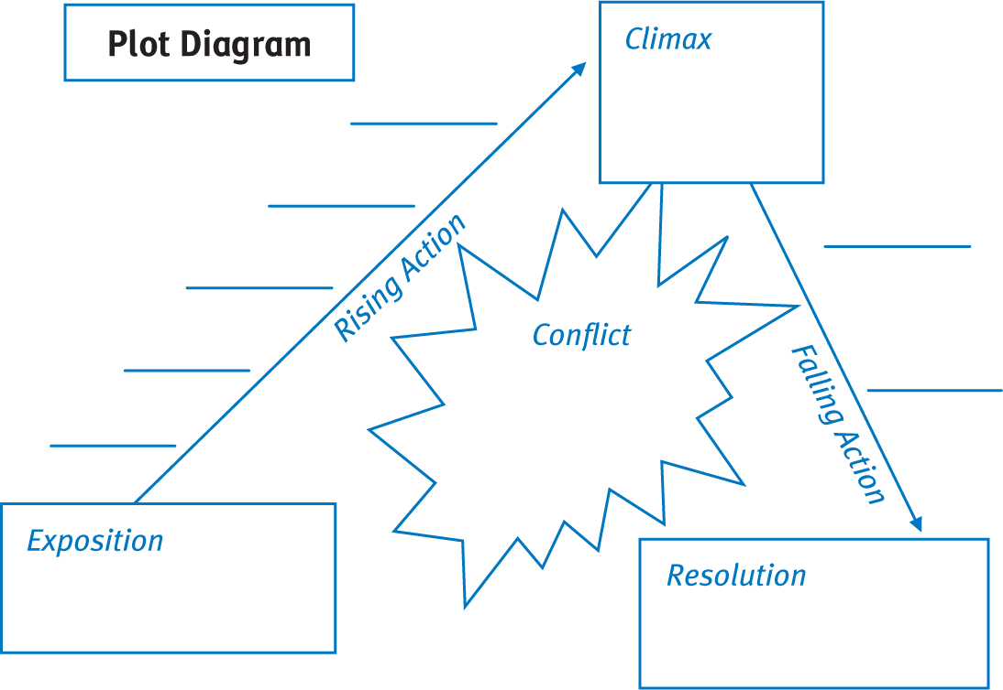
PAGE 49

