Slide 1
OPENING APRIL 21, 2016
America’s First Earth Day
The paragraph below tells about a special date in April history. Can you find and mark ten errors in the paragraph? You might look for errors of capitalization, punctuation, spelling or grammar.
In 1970, America’s air, water, and land where dirty and polluted. To get people more involved, Senator Gaylord Nelson asked people form all over the United States to help. On April 22, 1970 an estimated 20 million american celebrated the first Earth Day with activitys in schools, colleges, cities, and towns. That same year, the U.S. Enviromental Protection Agency (EPA) was establish to help clean up are country

Slide 2



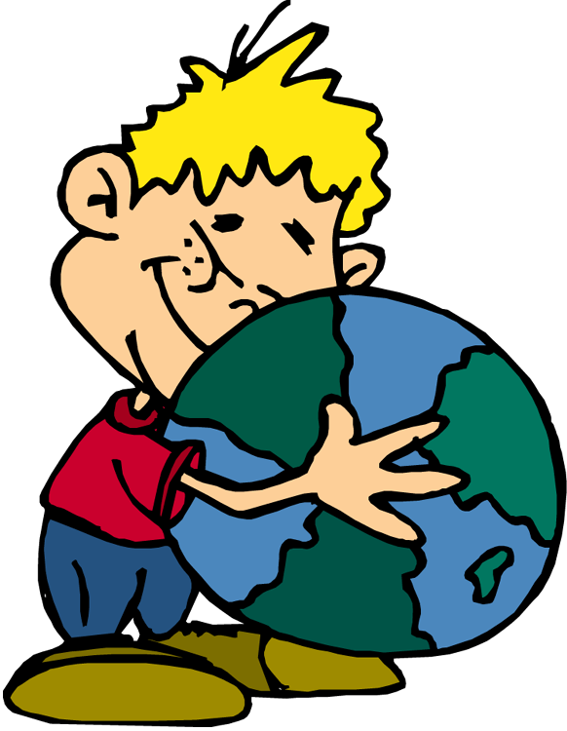

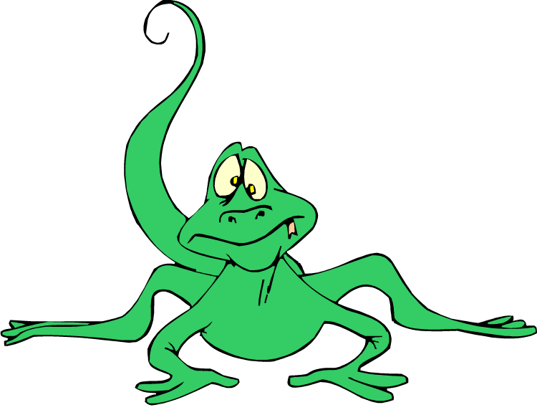
What is Earth Day?

Slide 3
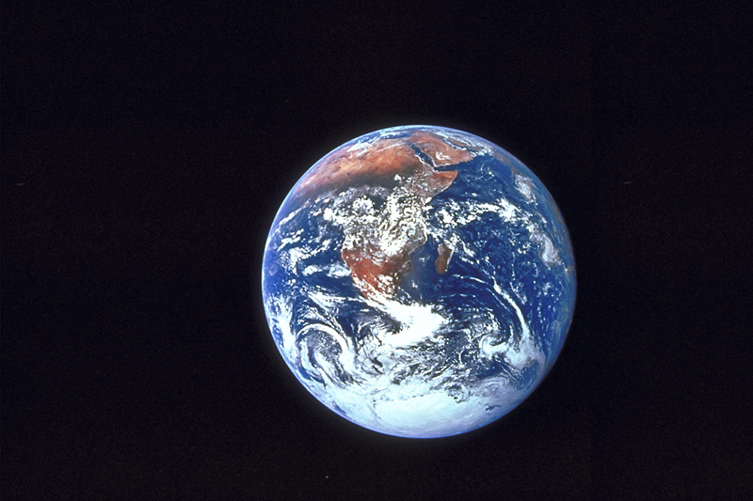
Earth Day is a global event.
Activities and events are held each year as a show of support for Earth’s environment.

Slide 4

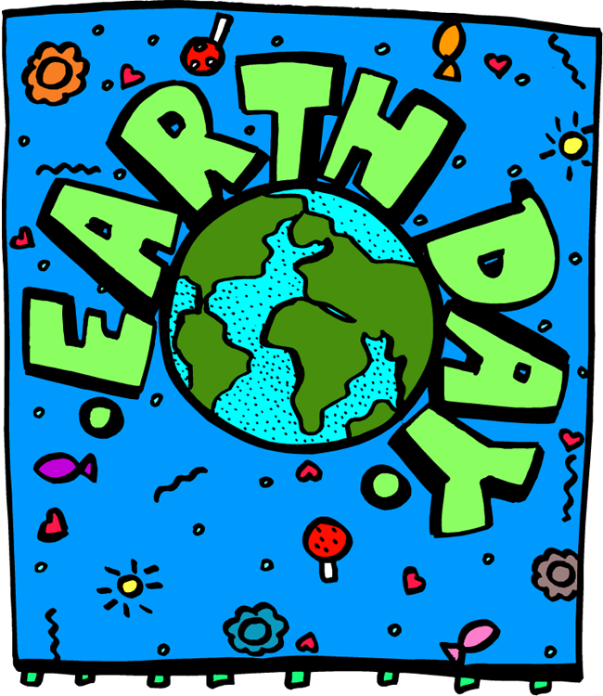
Earth Day is celebrated each year on April 22.

Slide 5
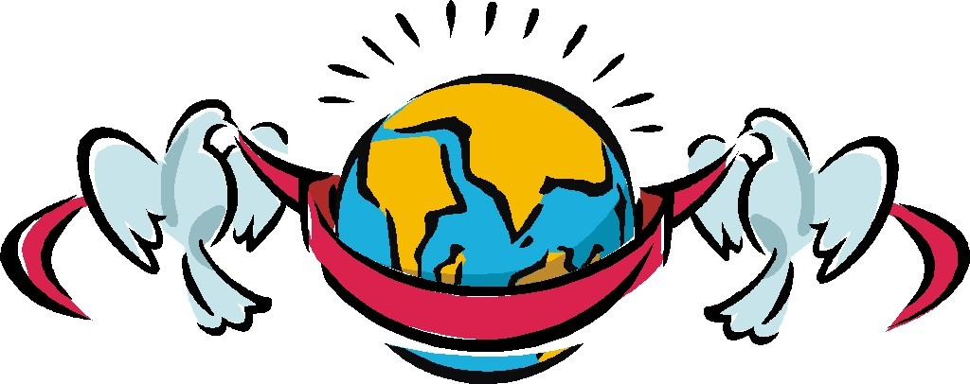
Earth Day is celebrated worldwide in over 192 countries.
The purpose is to show global support for the protection of our environment.

Slide 6

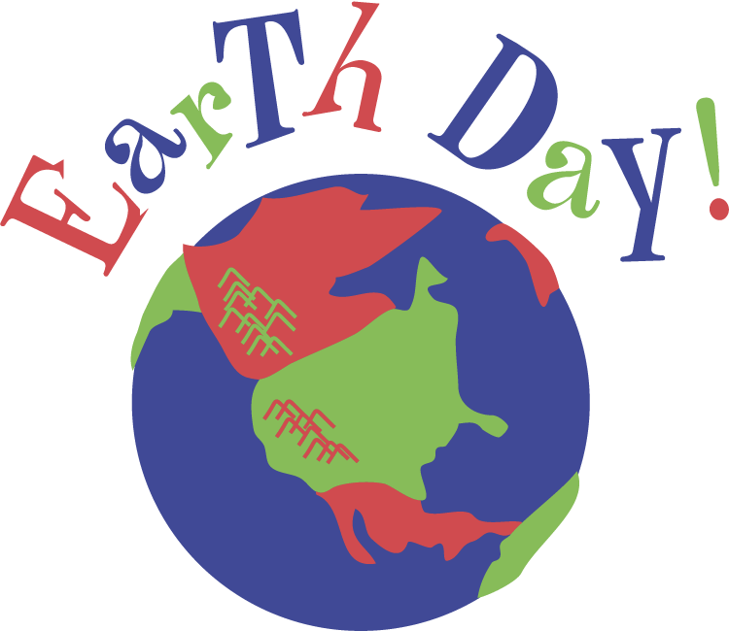
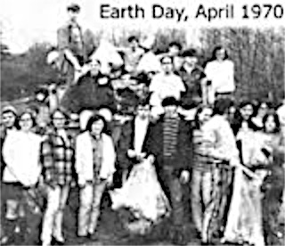
The first Earth Day was held on April 22, 1970.

Slide 7
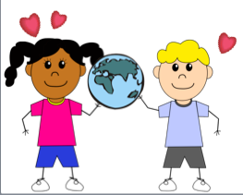
Why was Earth Day started?

Slide 8
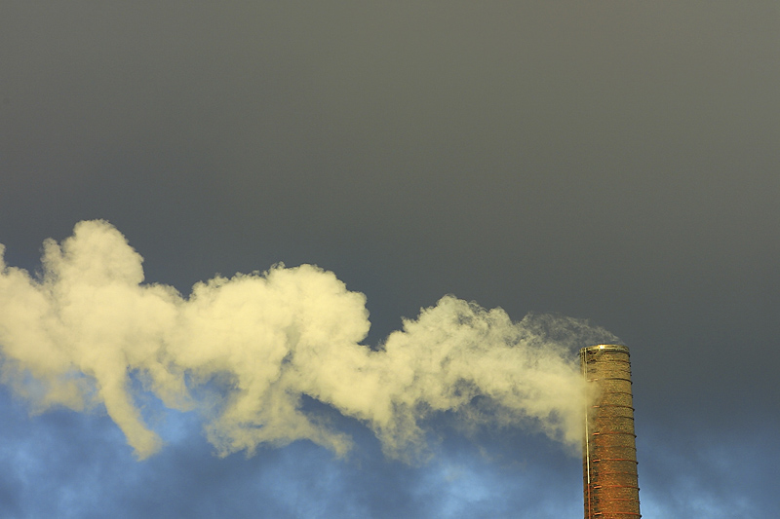
In the late 1960’s and into 1970, most Americans paid little attention to the damage being done to our environment.

Slide 9

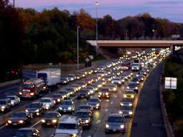
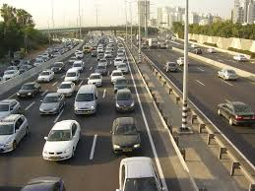
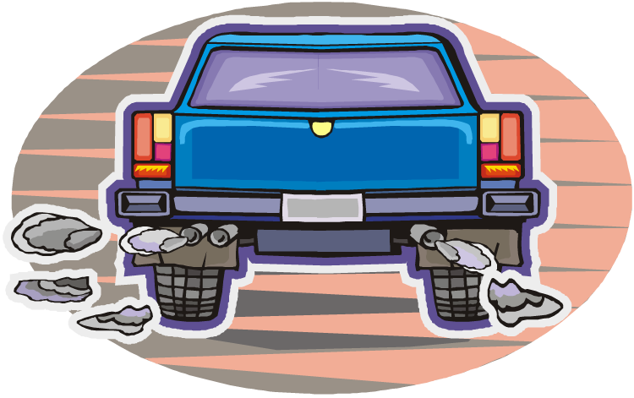
Most Americans drove very large cars that got very poor gas mileage. Not only were petroleum products being used excessively, but automobile emissions were polluting the air.

Slide 10
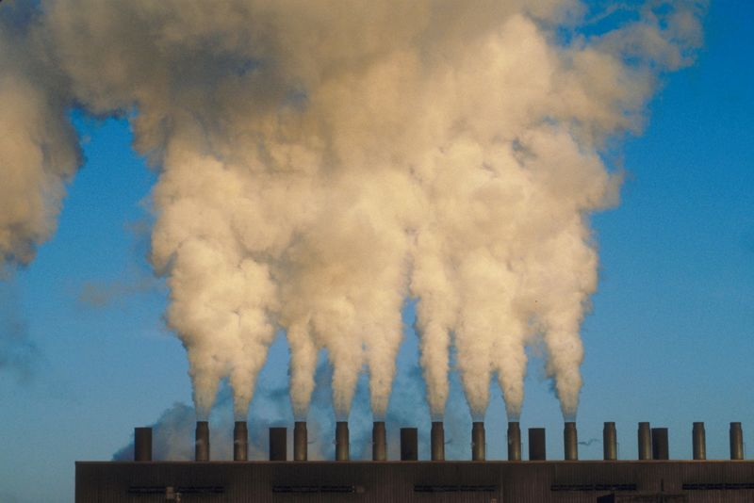
Many industries paid little attention to the damage they were doing to the environment.

Slide 11
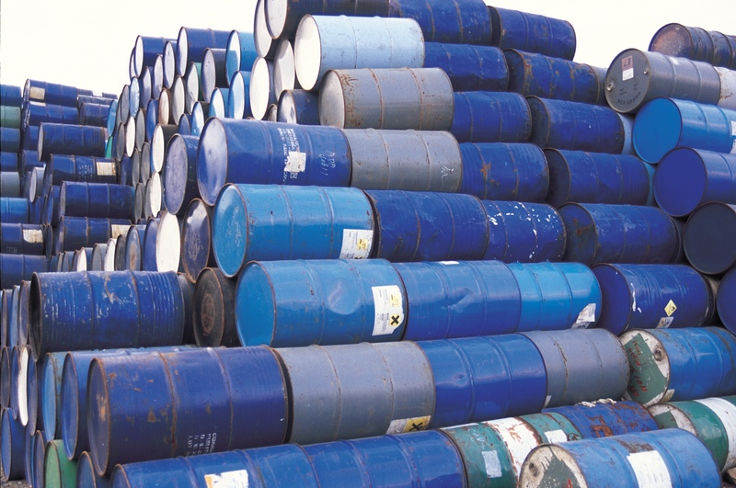
Earth Day 1970 was organized to promote awareness for our environment, and to encourage all people to take better care of the environment.

Slide 12

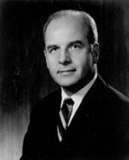
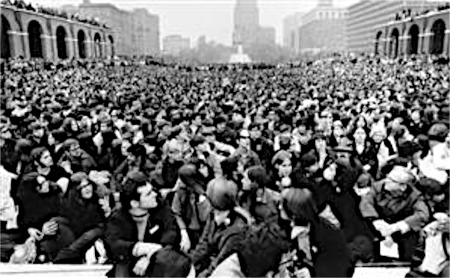

Gaylord Nelson, a US Senator from Wisconsin, proposed and organized the first Earth Day in 1970. As a result, on April 20, 1970, 20 million Americans took up the environmental cause and protested.

Slide 13


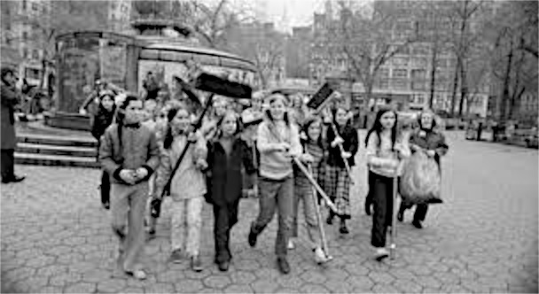
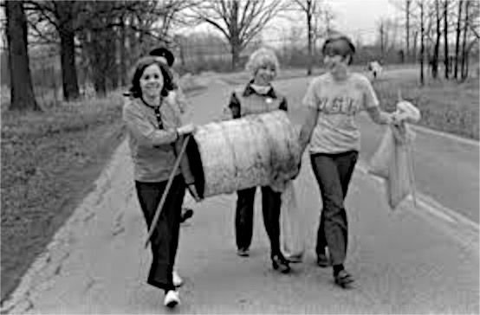
Thousands of schools, colleges and universities participated in the first Earth Day. The participants led peaceful demonstrations in favor of environmental reform.

Slide 14
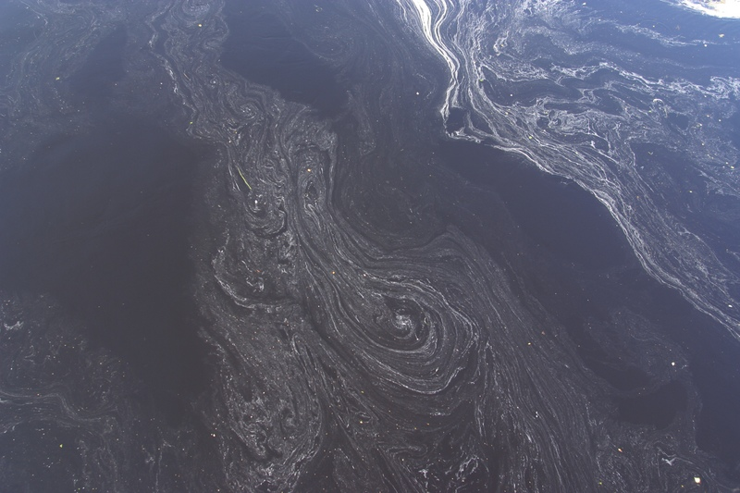
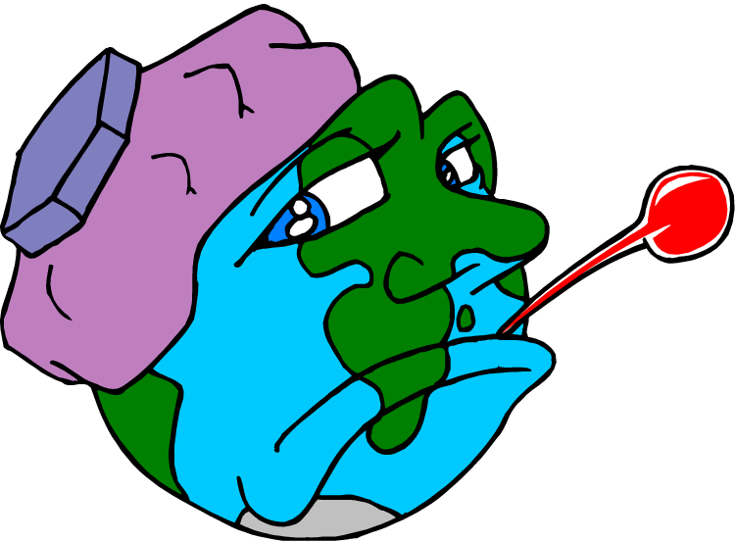
Americans protested against oil spills….

Slide 15
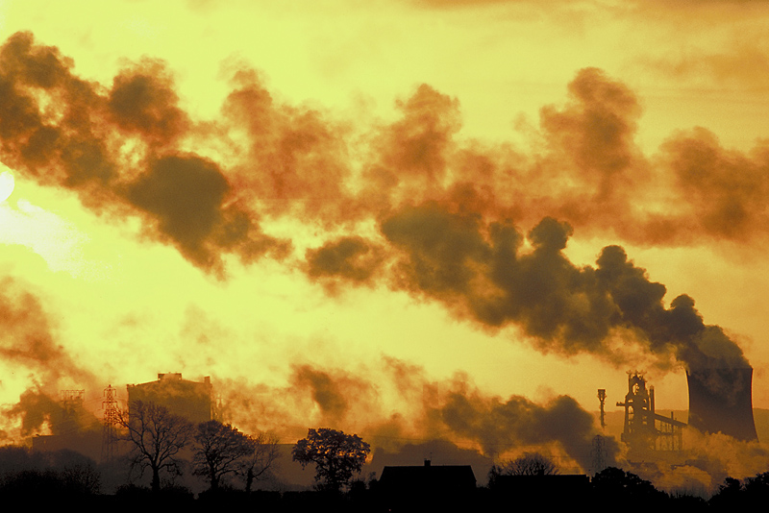
…polluting industries and power plants…..

Slide 16
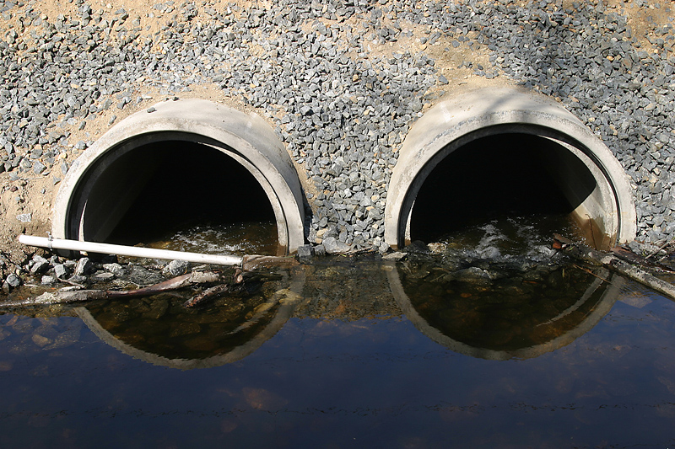
….the dumping of raw sewage….

Slide 17
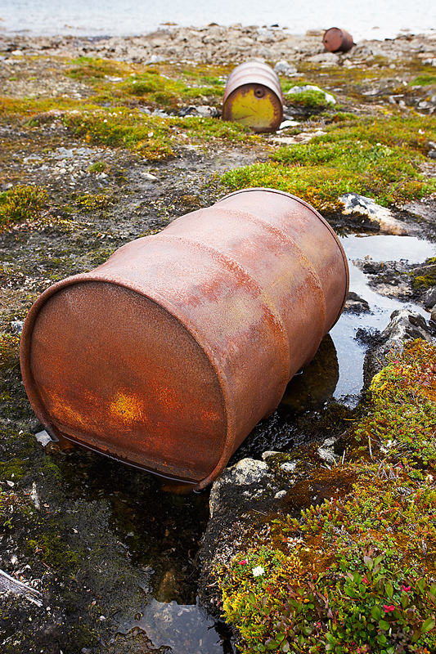
…..the dumping of toxins, such as pesticides and other toxic wastes, into streams and rivers…..

Slide 18
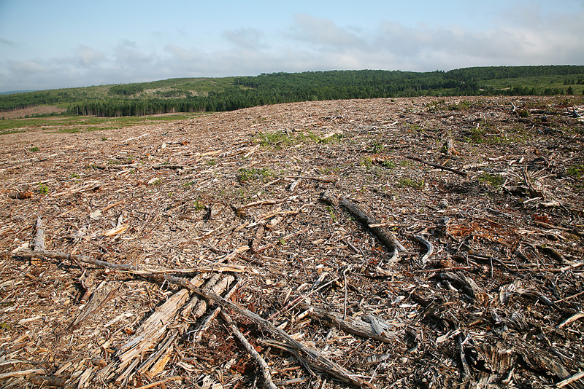
…..the loss of wilderness and deforestation…..

Slide 19
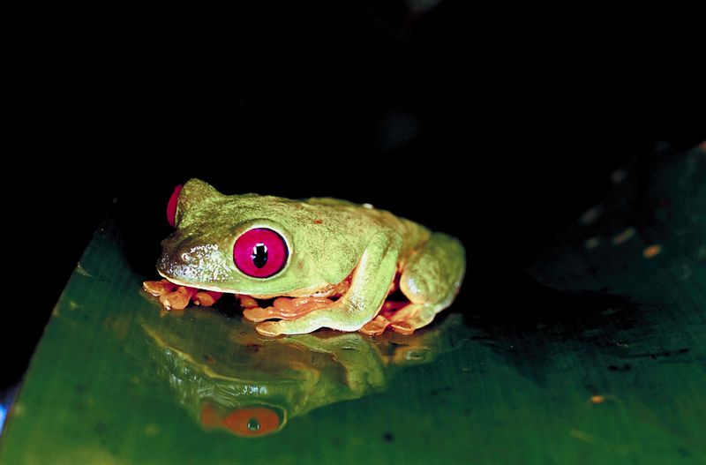
…..and the extinction of many wildlife species.

Slide 20
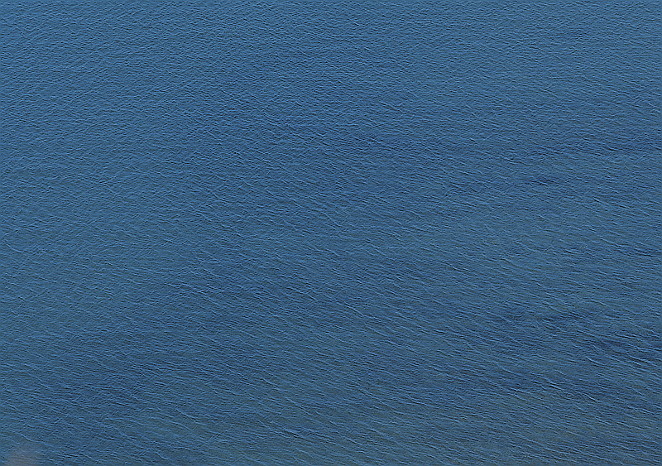

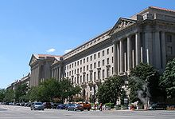

The first Earth Day led to the creation of the United States Environmental Protection Agency and the passage of the Clean Air, Clean Water, and Endangered Species Acts.

Slide 21


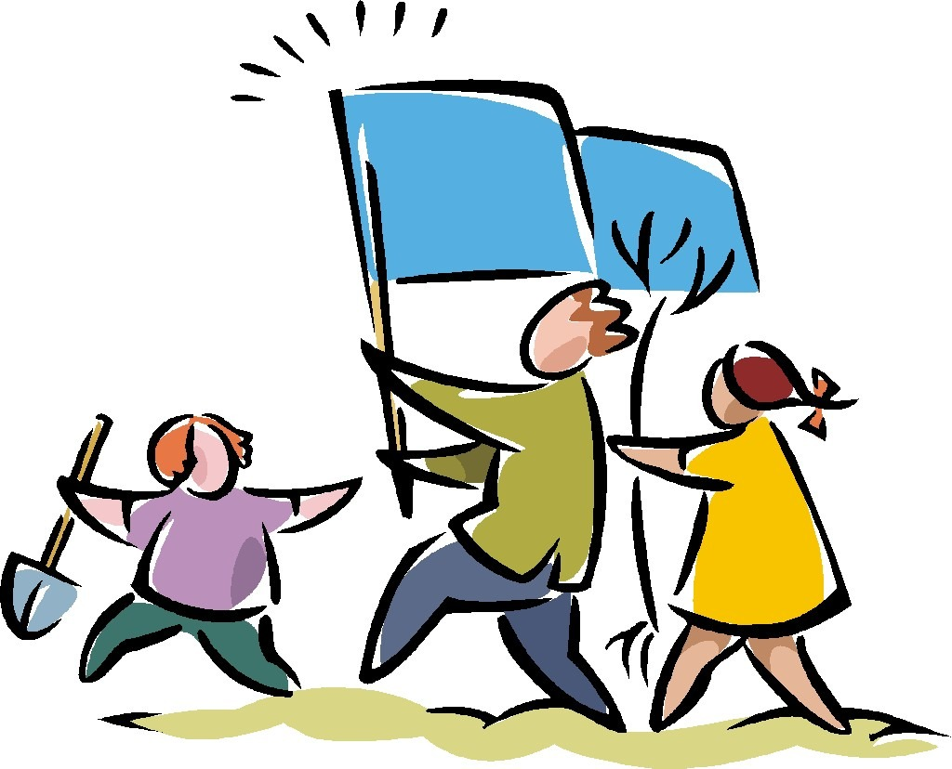
In 1990 Earth Day went global, mobilizing 200 million people in 141 countries

Slide 22
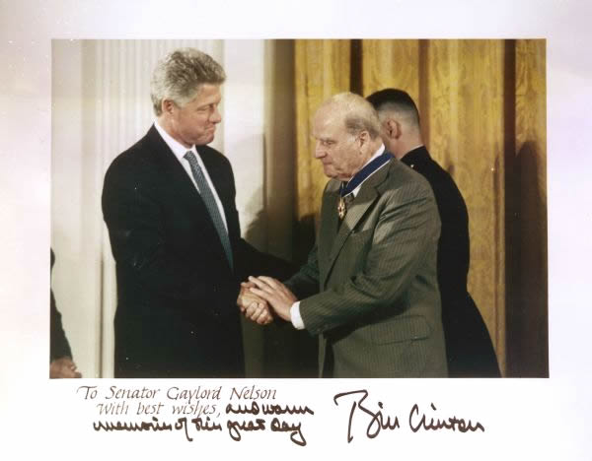
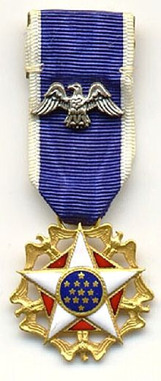
In 1995 President Bill Clinton awarded Senator Nelson the Presidential Medal of Freedom -- the highest honor given to civilians in the United States -- for his role as Earth Day founder.

Slide 23
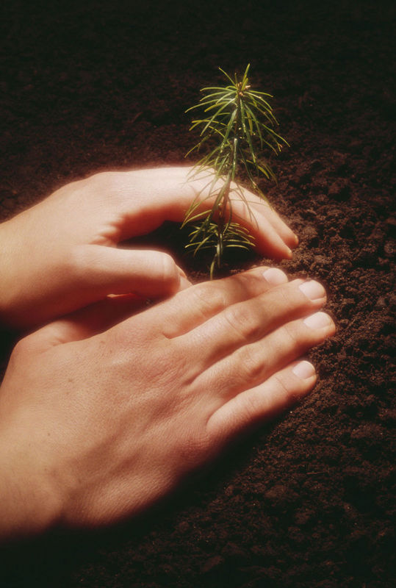

In 2010, on the 40th anniversary of Earth Day, the Earth Day Network launched a “Billion Acts of Green.” Participants were asked to register their “acts of green” and state what they were doing to protect the environment.

Slide 24

By April 22, 2012, one billion actions had been recorded by the people of the world.

Slide 25
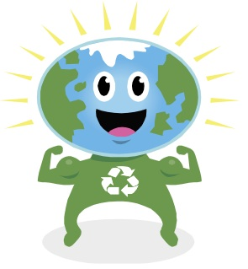
The Earth Day Network has now set as its goal, 2 billion “acts of green.”
You can record your actions here: http://act.earthday.org/index.html

Slide 26

What can you do to protect the Earth?
What is your goal for Earth Day?
Happy Earth Day!

Slide 27
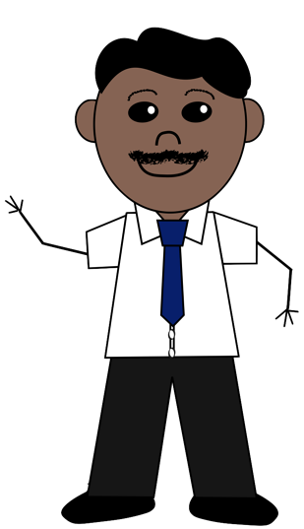
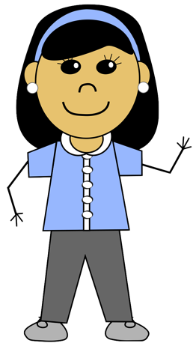
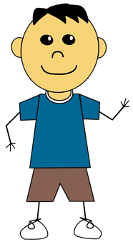

These adorable little people…….
…..are copyrighted images and may not be used without the permission of their creator.
These images were created and copyrighted by Tracee Orman. They are available for purchase in Tracee’s store on TeachersPayTeachers.com.
Click HERE to view all of Tracee’s clip art collections.

Slide 28


Created by Amy Brown
Copyright © Amy Brown Science
All rights reserved by author.
This document is for your classroom use only.
This document may not be electronically distributed or posted to a web site.

