Slide 1
Prepare to discuss.

Slide 2
SUMMARIZE EACH DEFINITION BELOW… THEN COPY THE EXAMPLE…
PRONOUN – A pronoun is a word that you use to refer to someone or something when you do not need to use a noun, often because the person or thing has been mentioned earlier. Examples are 'it,' 'she,' 'something,' and 'myself.'
ANTECEDENT – A word, phrase, or clause that is replaced by a pronoun
EXAMPLE - Jane lost a glove and she can't find it.
Jane is the antecedent of she and glove is the antecedent of it.

Slide 3
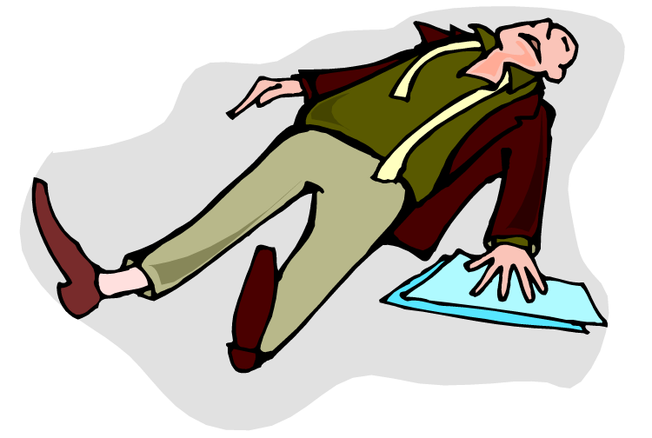
Pronoun Agreement
Until You Pass Out !
https://www.flocabulary.com/unit/pronouns/

Slide 4
Rule 1: Know the general rule governing pronoun agreement.
A pronoun must agree with its antecedent.
The antecedent is usually a noun that the pronoun replaces. For example, you can replace Mrs. Hill with she or her, the students with they or them.

Slide 5
Here are two examples:
The lizard licked its eyeball.
Lizard = singular antecedent its = singular pronoun
The lizards licked their eyeballs.
Lizards = plural antecedent their = plural pronoun

Slide 6
Know the difference between these singular and plural personal pronouns.
Singular
He, she, it
Him, her, it
His, hers, its
Himself, herself, itself
Plural
They
Them
Their, theirs
Themselves

Slide 7
Do not confuse it’s with its.
It’s [with an apostrophe] means it is or it has.
Its [without an apostrophe] means belonging to it—for example, its bowl, its sharp teeth, its long claws, etc.
Possessive pronouns—unlike possessive nouns—do not need an apostrophe with the final s.

Slide 8
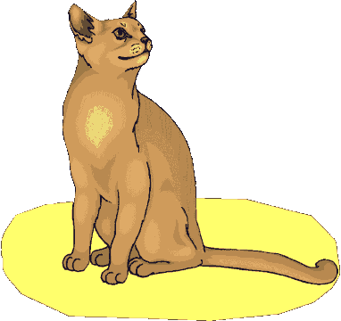
Rule 2, Part 1: The conjunction and can cause problems with pronoun agreement.
Two [or more] singular things joined by and become a plural antecedent.
The new puppy and kitten have destroyed their owner’s sofa.

Slide 9
Rule 2, Part 2: When each or every precedes two [or more] singular things joined by and, a singular antecedent is formed.
Each new puppy and kitten destroys its owner’s sofa.

Slide 10
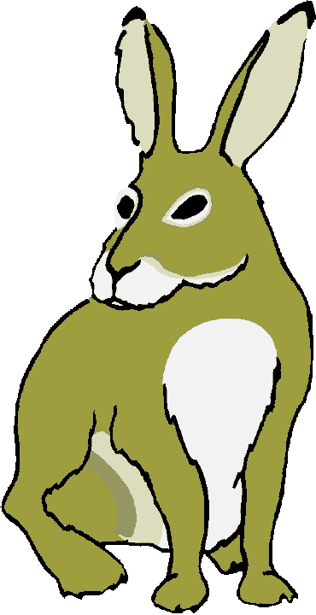
In this situation, no matter how many singular nouns that you join with and, the antecedent is still singular.
Each new puppy, kitten, rabbit, tarantula, python, parrot, iguana, and ferret destroys its owner’s sofa.

Slide 11
Rule 3: Use caution with these three correlative conjunctions: either … or, neither … nor, and not only … but also.
Of the two antecedents in the sentence, the pronoun must agree with the closer one.

Slide 12
Here are two examples:
Not only Louise but also the Smiths fixed their famous squid eyeball stew for the picnic.
Not only the Smiths but also Louise fixed her famous squid eyeball stew for the picnic.
+
=

Slide 13
Indefinite pronouns cause the biggest headaches for pronoun agreement.

Slide 14
Rule 4, Part 1: These indefinite pronouns are always singular [even when they seem plural].
Each, either, neither
Anyone, anybody, anything
Everyone, everybody, everything
No one, nobody, nothing
Someone, somebody, something

Slide 15
Everyone on Earth = more than one person—billions of people, in fact. The word everyone, however, is still singular and requires a singular pronoun for agreement.

Slide 16
Read this example:
Neither of my two brothers show much sense when they date women.
This sentence might sound right, but it is completely wrong!
Neither of my two brothers shows much sense when he dates women. [Neither = singular.]

Slide 17
Wow, what a babe!
Wow, what a fat wallet!

Slide 18
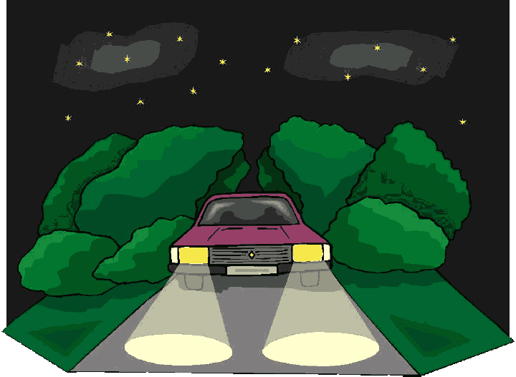
Now imagine a parked car like this one:

Slide 19
Rule 4, Part 2: When fixing an agreement error, try to avoid sexist language that might offend your readers.
The sentence below sounds natural but has an error.
Someone left their lights on.

Slide 20
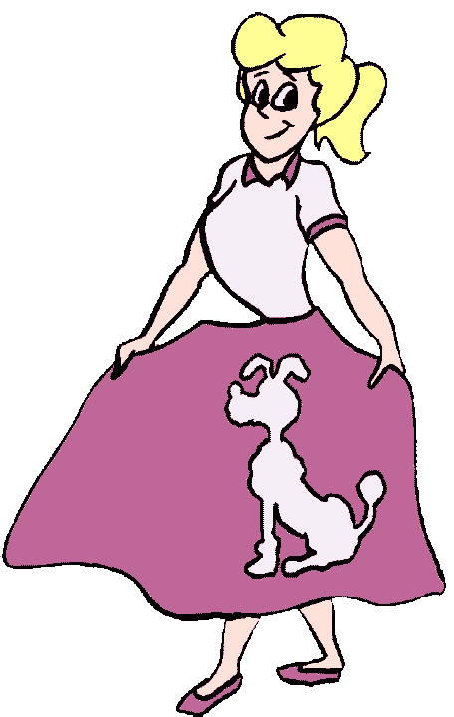
In the 1950s, rule books would have recommended using the masculine pronoun exclusively.
Oh, my! Someone left his lights on.

Slide 21
In the 1970s, after criticism from feminists and civil rights activists, rule books next suggested using both genders so that males and females had equal representation in the language.
I can see them along the watch tower . . .
Someone left his or her lights on.

Slide 22
A writer who begins with he or she or him or her will need to be consistent. But look what happens . . .

Slide 23
Oh, the horror !
Wanda Wrighter
Professor Pennington ENC 1101 May 17, 2011
Student Success
If a student wants to improve his or her grades, he or she should walk himself or herself over to the tutoring center. There, he or she can request a tutor to help him or her with his or her homework. This preparation for his or her class will ensure that he or she is ready when taking his or her quizzes and exams. In addition, the tutor might have old work to share. This way, the student can find out himself/herself what to expect on the assignments for a specific instructor that might change his/her assignments rarely. Thus, the one thing that will insure the success of a student is that he or she gets a tutor to help him or her.

Slide 24
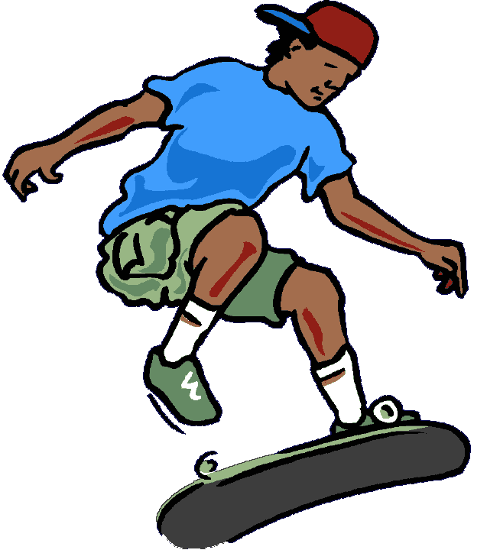
In the 21st century, fix the error without the annoying repetition.
There’s a car with its lights on.
Thankfully, my wheels don’t have that problem.

Slide 25
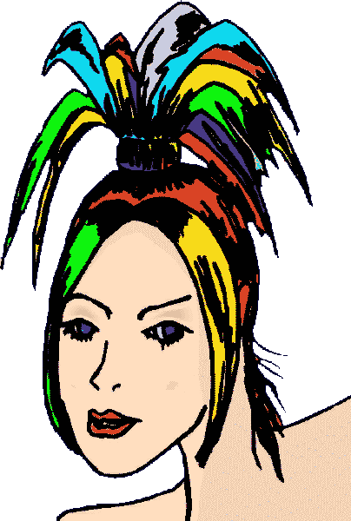
Rule 4, Part 3: Some indefinite pronouns are singular or plural, depending on context.
All of Beverly’s hair gets its color from a bottle.
All of Beverly’s fingernails get their color from a bottle.
All
Any
None*
More
Most
Some
Notes:
According to the Gregg Reference Manual, “In formal usage, none is still considered a singular pronoun. In general usage, however, none is considered singular or plural, depending on the number of the noun to which it refers. No one or not one is often used in place of none to stress the singular idea” (214).
According to Kolln and Funk’s Understanding English Grammar, “A more accurate way to assess its meaning is to recognize none as the negative, or opposite, of all and to treat it in the same way, with its number (whether singular or plural) determined by the number of the modifier or of the referent” (262).

Slide 26
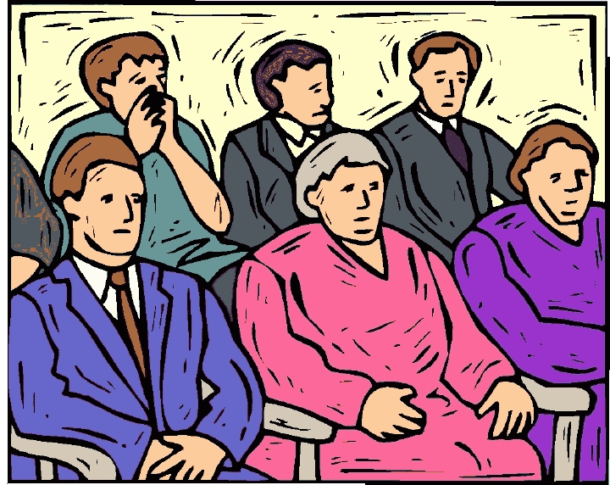
Some groups of people, like a jury, also cause pronoun agreement problems.

Slide 27
Rule 5: Collective nouns are singular or plural, depending on context.
Collective nouns are groups of people: team, jury, class, committee, army, family, etc.
If all members are acting in unison, treat the collective noun as singular and use a singular pronoun.
If, however, all members are acting individually, treat the noun as plural and use a plural pronoun.

Slide 28
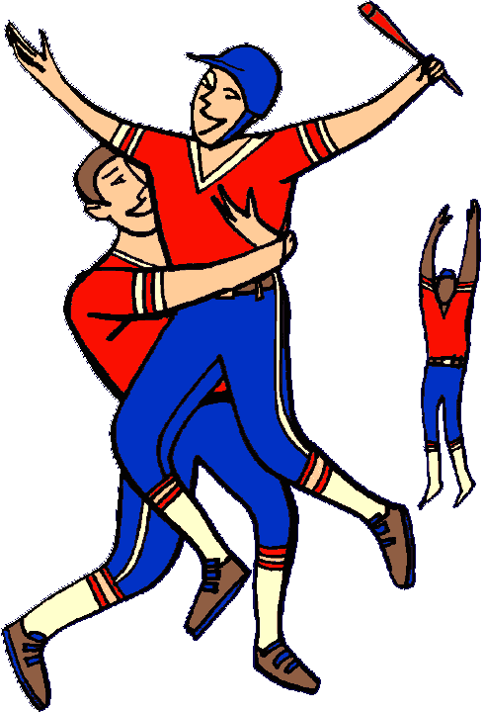
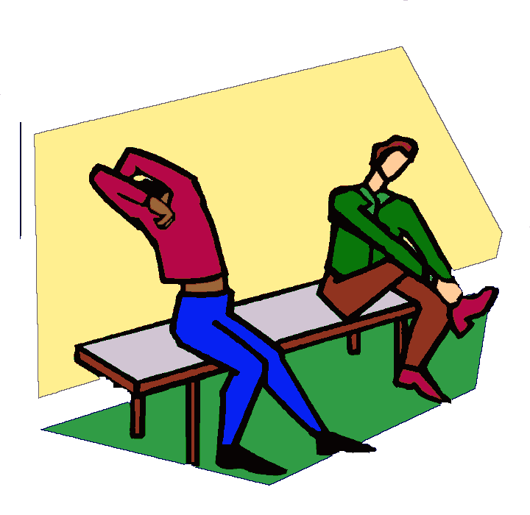
Read these examples:
The team celebrated its victory.
The team changed into their street clothes and went home happy.

Slide 29
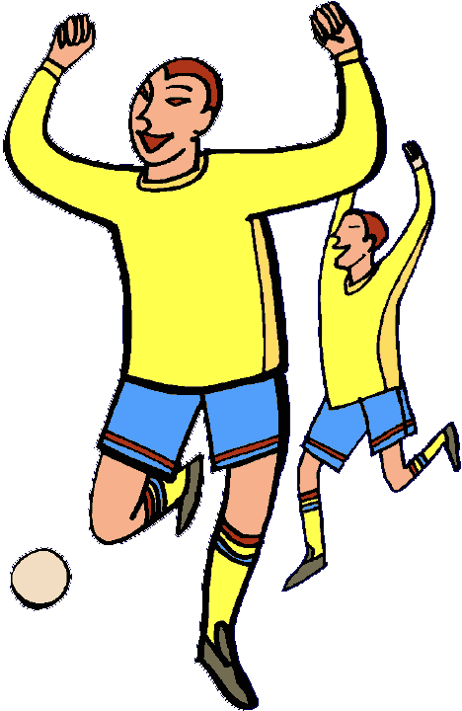
When you cannot decide if the collective noun is singular or plural, insert a plural noun after the collective noun, like this:
The team members ran out onto the field to meet their opponent.

Slide 30
Rule 6: Companies, organizations, and schools are singular and thus require singular pronouns.
One urban legend is that Tito’s Taco Palace makes its burritos with kangaroo meat.
The Pencil Enthusiast Society uses the donations it receives to insure all writing instruments have sharp points.
Next year, Weaver College will try to solve its parking woes by requiring students to buy a $75 parking decal.

Slide 31
Learning Targets – Page 61
Compare and contrast character traits that lead to self-destruction in a myth.
Analyze the relationship between character and plot and between conflict and resolution.

Slide 32
Preview
In this activity, you will read a myth whose main character’s traits lead to self-destruction.

Slide 33
Introducing the strategy DIFFUSING
With this strategy, you use context clues to help find the meaning of unknown words. When diffusing, circle words that are unfamiliar. Think of two possible substitutions (synonyms), and confirm your definition. You can confirm your definition by checking reference sources such as a dictionary or a thesaurus.

Slide 34
Setting a Purpose for Reading
As you read the myth, underline details you learn about Arachne’s character.
Circle unknown words and phrases. Use the diffusing strategy to try to determine substitution words based on context clues. Confirm your definition by checking a dictionary or thesaurus.

Slide 35
About the Author
Olivia Coolidge grew up in England in the early 1900s. She became a teacher of Latin, Greek, and mythology, while also developing her skills as a writer. She wrote numerous histories and biographies for children and young adults. Her work is noted for high interest and vivid descriptions. Coolidge won the 1963 Newbery Award for contributions to children’s literature.

Slide 36
“Arachne”

Slide 37
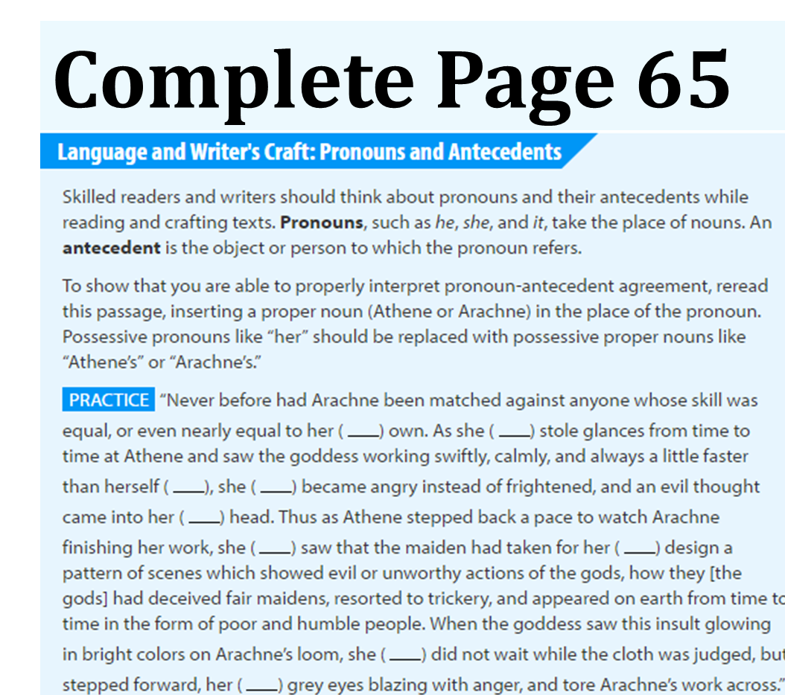
Work Period
Pages 63-65
1,2,3,4,6, &7

